Slide 2
Inductive Bible
Study Method

Slide 3
Welcome back to IBSM
Bite 03

Slide 4
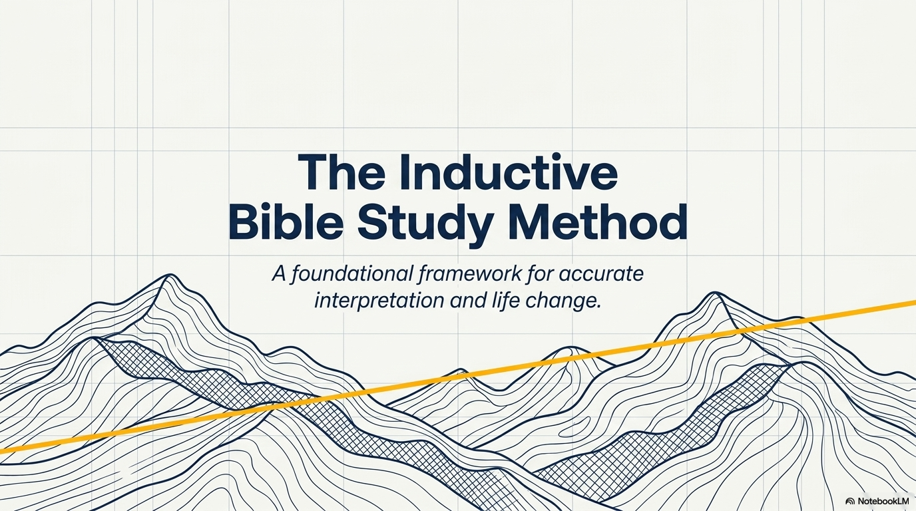

Slide 5
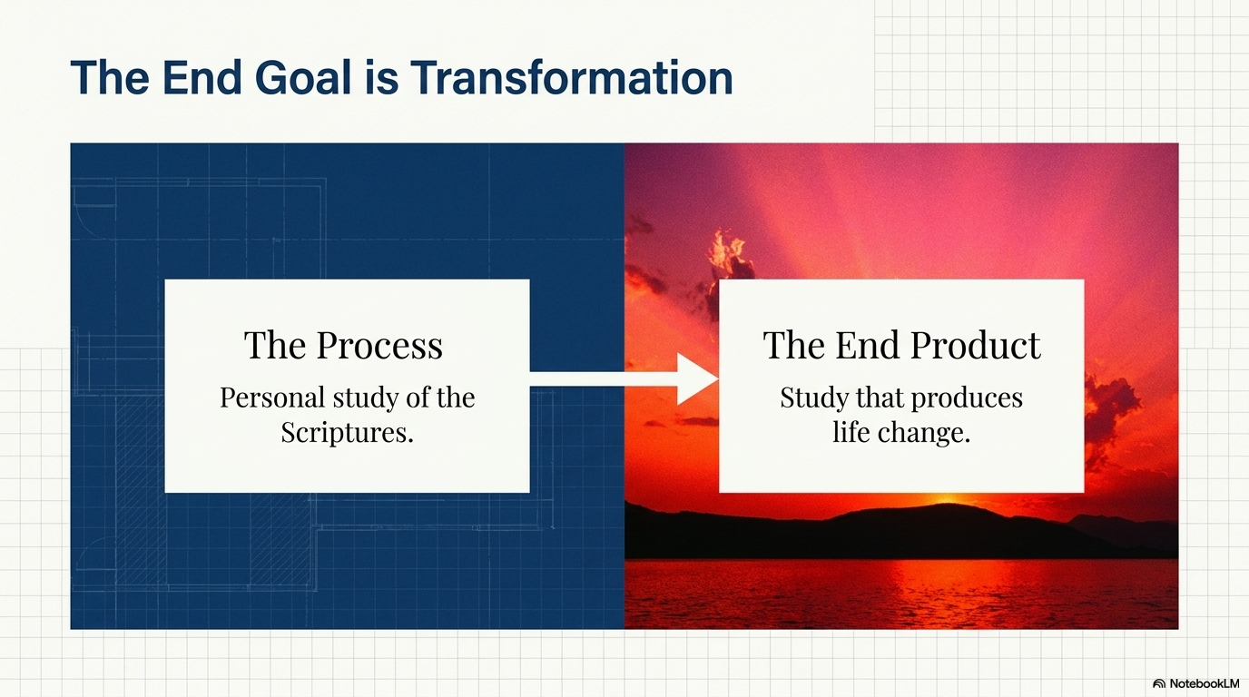

Slide 6

Bible study is . . .
methodicalness

Slide 7
Method is Methodicalness…
Involves:
Take certain steps
In certain order
To bring about certain results
Notes:
Methodical / Systematic – involves taking certain steps in a certain order to bring about a certain result. Not just any steps, not just any order, not just any result:

Slide 8
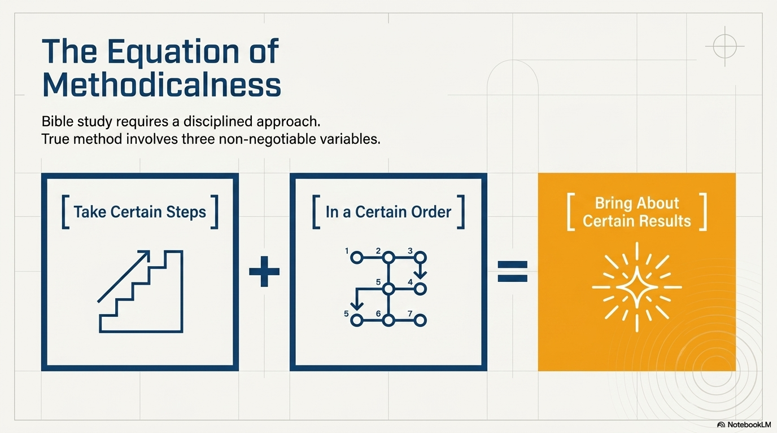

Slide 9
The end product
Personal study of the Scriptures
Study that produces life change

Slide 10
The process
Observation
Interpretation
Application

Slide 11

I. Observation
What?
What do I see?

Slide 12


Slide 14
OBSERVATION
1) Terms
2) Structure
3) Literary Form (Genre)
4) Atmosphere

Slide 15
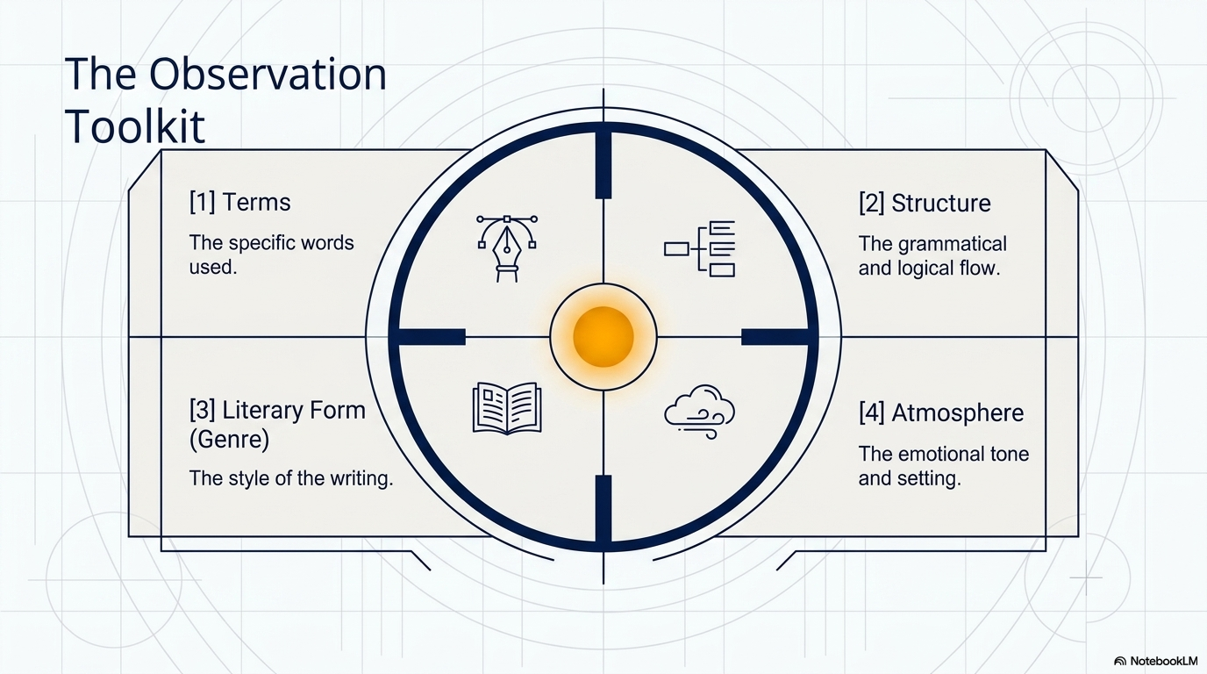

Slide 16


Slide 17

I. Observation
II. Interpretation
What does it mean?

Slide 18
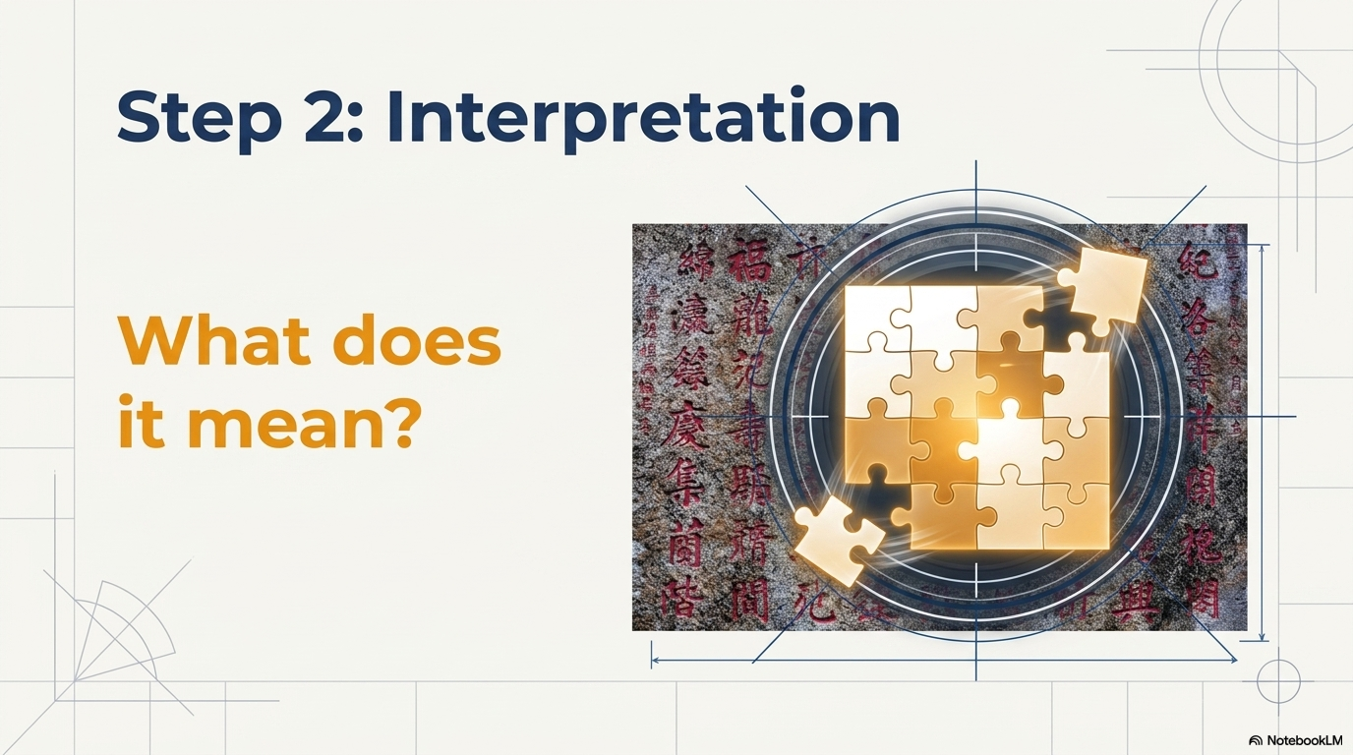

Slide 19
INTERPRETATION
Many Questions
Find Some Answers
Put Them All Together

Slide 20

I. Observation
II. Interpretation
III. Application
What does it mean to me?

Slide 22
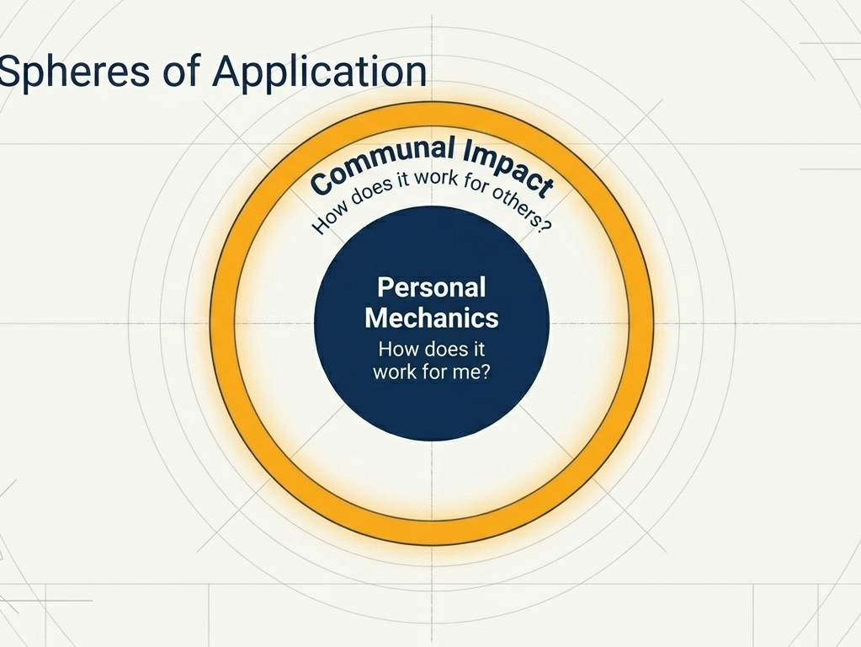

Slide 23
APPLICATION
How does it work for me?
How does it work for others?

Slide 24

Review
#1 Observation
#2 Interpretation
#3 Application

Slide 25
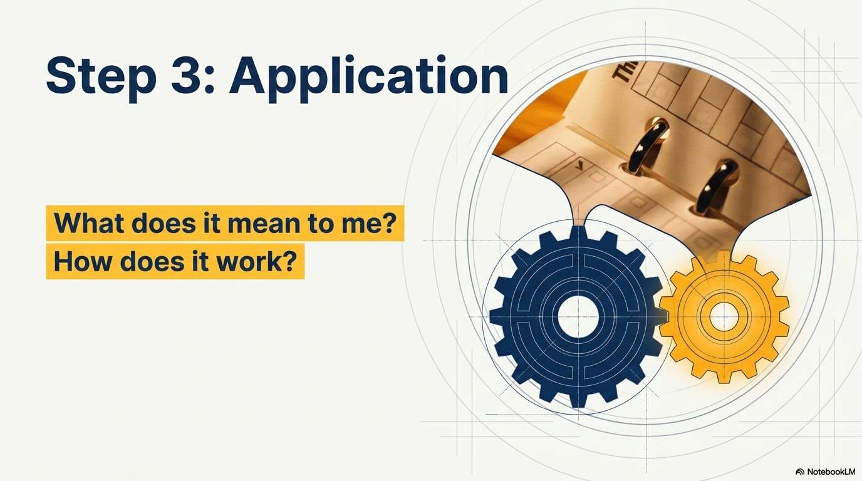

Slide 26
Three Steps
What do I see?
OBSERVATION
Inductive Bible Study Methods
APPLICATION
INTERPRETATION
How does it work?
What does it mean to me?
What does it mean??
Notes:
Use body gesture to help you remember:
Observation – multitude – a large number of things you should pay attention to. The better you observe, the more you’ll notice. The more you notice, they better you are in understanding the meaning of a passage.
Interpretation – one – when the author wrote a particular passage, he had one intended meaning in mind. In other words, he does not leave it to his audience to come up with whatever meaning. Rather, he had a specific purpose or meaning in mind. Kind of like The Boy who Cried Wolf story. The author had a particular message in mind when he wrote/told the story.
Application - many

Slide 27
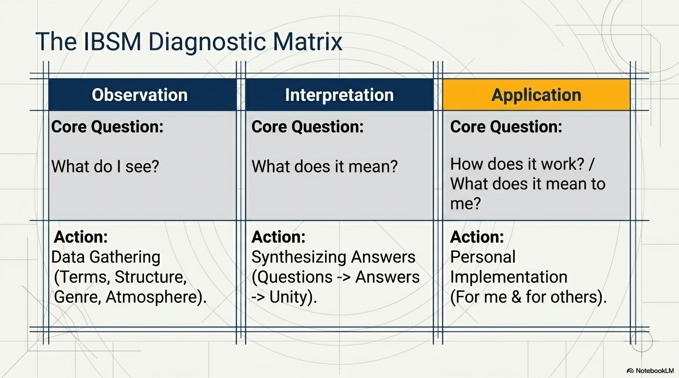

Slide 28
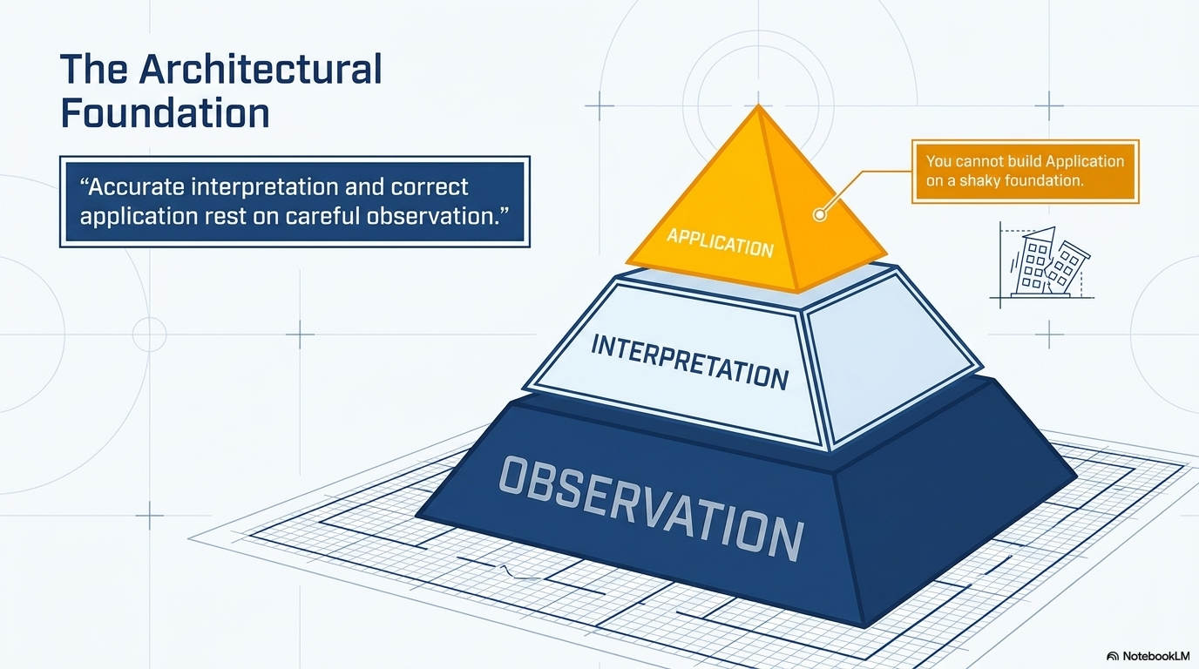

Slide 29

Accurate interpretation and correct application rest on careful observation

Slide 30

Start by learning how to observe…more specifically, how to read!

Slide 31
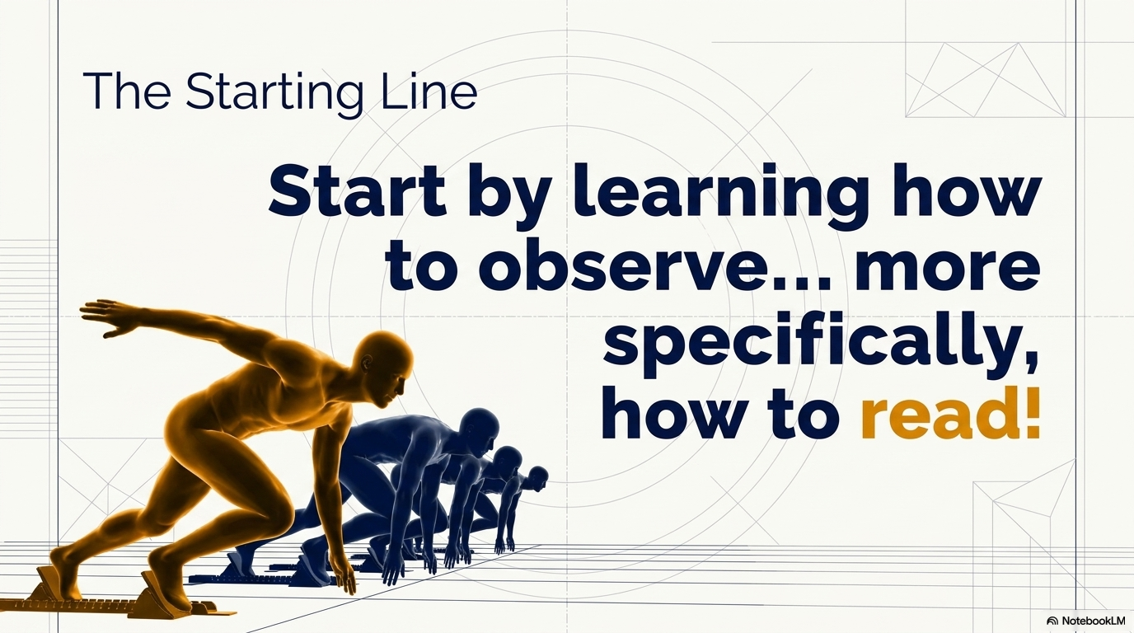

Slide 32
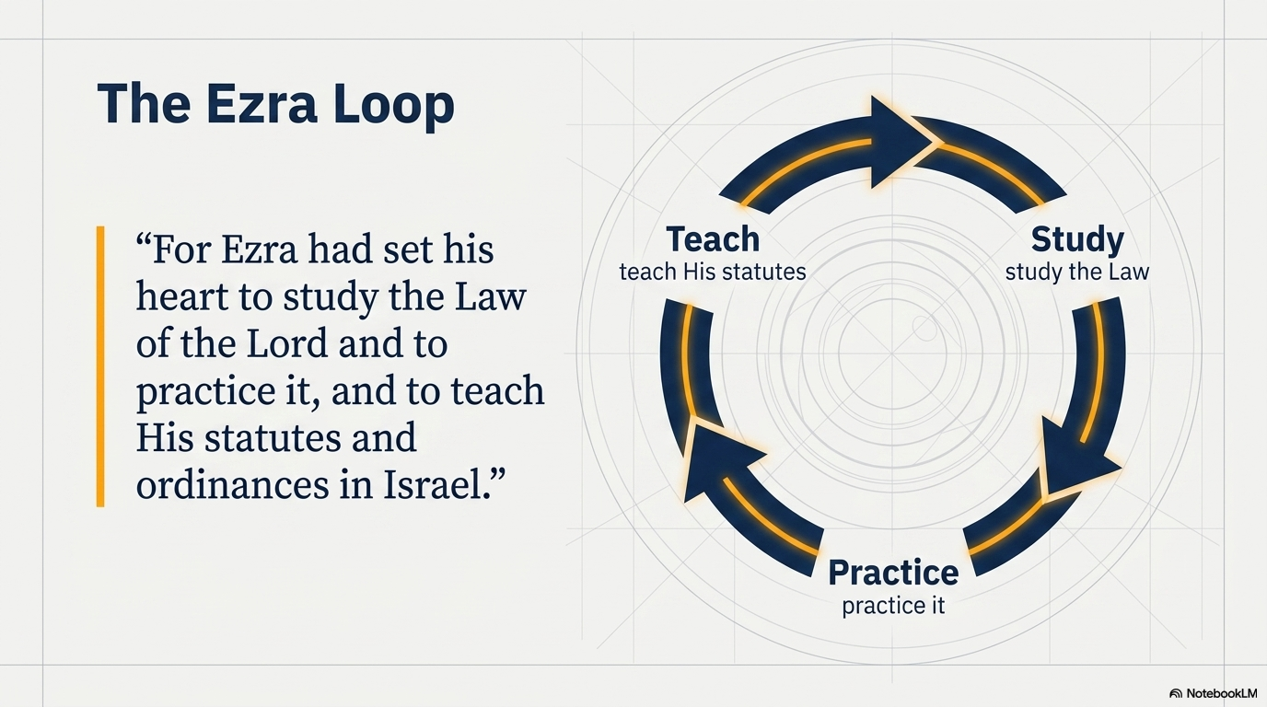

Slide 33

For Ezra had set his heart to study the Law of the Lord and to practice it, and to teach His statutes and ordinances in Israel.

Slide 34
Now there was a man of the Pharisees, named Nicodemus, a ruler of the Jews; this man came to Jesus at night and said to Him, “Rabbi, we know that You have come from God as a teacher; for no one can do these signs that You do unless God is with him.”

Slide 38


